Slide 1

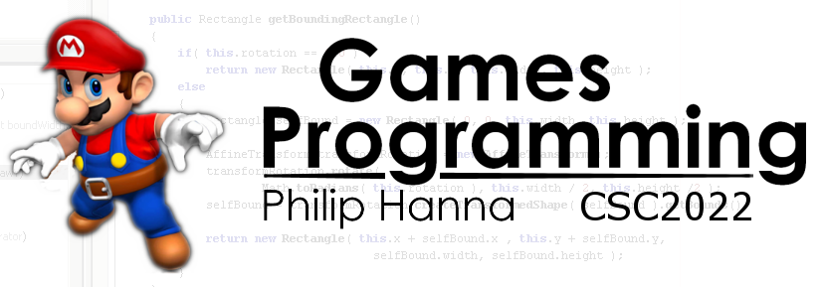
AI Decision Making
Enabling AI game agents to make sensible decisions

Slide 2

Decision Making AI

Slide 3
The input to a decision making process is the knowledge possesses by a game object and the output is a requested action.
The input knowledge can consist of internal knowledge (i.e. internal state) and external knowledge (i.e. game world).
Likewise, actions can be directed towards changing internal state or the external (world) state.
Internal change (s)
Internal knowledge
Decision Making Process
Requested action(s)
External knowledge
External change (s)

Slide 4

Decision Trees

Slide 5
: Decision Trees
IsDangerous
Yes:IsClose
Yes:IsFleeing
No:Move
Yes:Flee
No:IsClose
Yes:Chase
No:Attack
Decision trees offer a simple, but fast form of decision making.
A decision tree contains a starting decision point, which is connected to more refined decision points. Each leaf contains an action that is executed once reached.
The tree can be grown to encapsulate complex behaviour but then often becomes hard to manage.

Slide 6
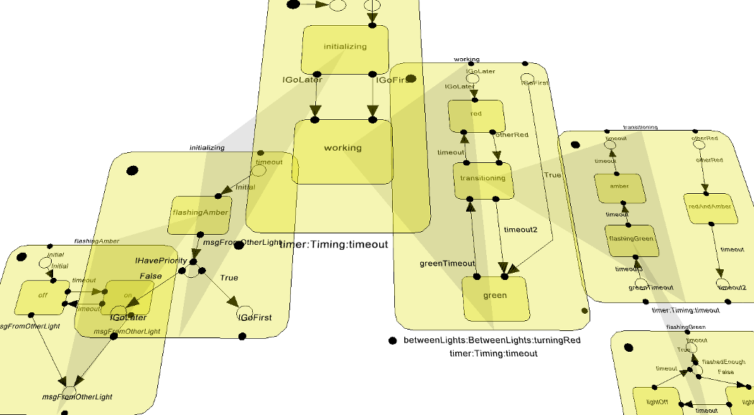
Finite State Machines

Slide 7
A_{S2}
A finite state machine (FSM) occupies one of a finite number of states at any point in time. Actions may be taken based on the current state. Inputs to the system can cause a transition from one state to another.
S2
A_{S1}
T₂
T₄
S1
T₁
T₃
S3
A_{S3}
In general:
Each FSM has a number of possible states {S1 ... SN}
Transition functions {T1 ... TM} define the conditions under which a state transition will occur.
Every time a state transition occurs and a new state is entered, one or more state actions may be fired {AS1 ... ASN }

Slide 8
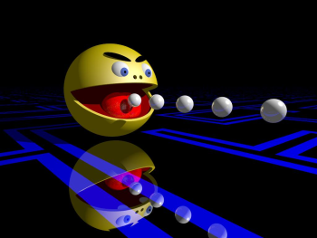
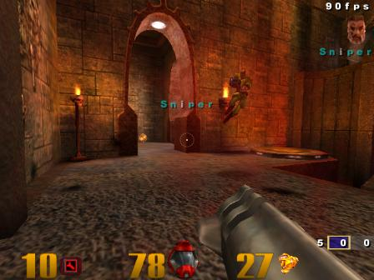
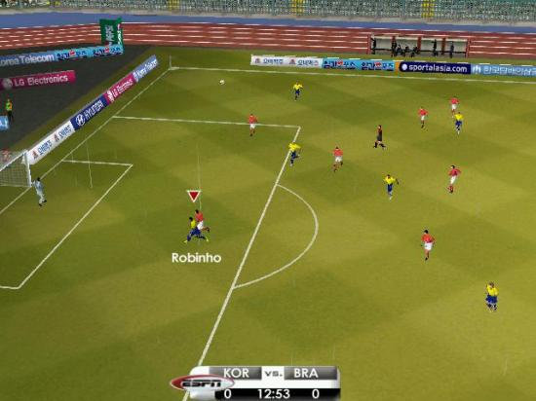
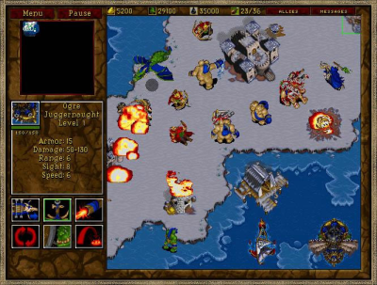
A finite state machine works by decomposing an object’s behaviour into defined chunks (states). So long as a character remains in a state it will use the same behaviour.
State machines are very widely used, including:
Controlling ghosts in Pac-man
Controlling bots in FPS games
Sports simulations
NPCs in RTSs

Slide 9
: Pacman Example
Each ghost can be in a wander, chase or evade state (each ghost can have a different chase/wander behaviour).
Once a powerpill is eaten, all ghosts transition to the evade state, which is exited once the timer expires.
Pacman in range
Wander()
Powerpill eaten
Pacman out of range
Powerpill expired
Chase()
Evade()
Powerpill eaten
Aside: The wander state could be entirely removed in this FSM, i.e. Chase and Evade form the minimum behavioural set.

Slide 10
State machines along with scripting represent the most common forms of decision making in games, as:
They are relatively quick and simple to code and debug
They have little computational overhead (depending on the complexity of transition tests).
They are flexible and can often be easily extended or modified.
State based behaviour is good for modelling many game-world objects.

Slide 11
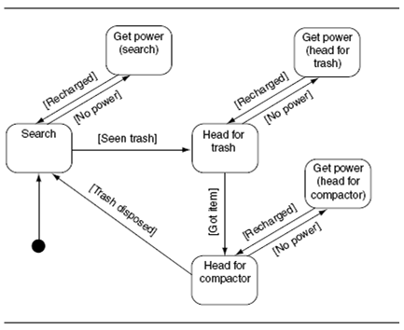
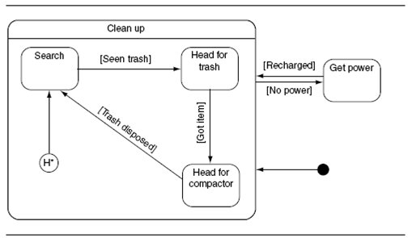
: Hierarchical
Simple FSMs cannot easily model all forms of behaviour. One example is ‘alarm behaviour’, an action that can be triggered from any state.
Consider a robot whose ‘alarm’ behaviour is to recharge when power levels become low.
Using a hierarchical FSM, the states can transition between ‘cleaning up’ and ‘getting power’. When in the ‘cleaning up’ state a lower-level FSMs controls behaviour.

Slide 12

Goal Oriented Behaviour

Slide 13

GOB is used widely in games such as The Sims. Characters have a range of ‘emotional’ or ‘physical’ goals (or motives). Depending on the actions executed by the character the goals (i.e. needs, desires, fears, etc.) will either increase or decrease.
GOB algorithms try to fulfil the character’s goals by selecting between available actions that influence the goal parameters.

Slide 14
Goals (Insistence low = 0, high = 5):
Eat (4), Sleep(1), Bathroom (3)
Actions:
Eat-Food (Eat − 3, Bathroom +1)
Eat-Snack (Eat − 2)
Sleep-Bed (Sleep − 4)
Sleep-Sofa (Sleep − 2)
Drink-Cola (Eat − 1; Bathroom + 3)
Visit-Bathroom (Bathroom − 4)
Discontentment:
Eat-Food: (4-3)² + 1² + (3+1)² = 18
Eat-Snack: (4-2)² + 1² + 3² = 14
Sleep Bed: 4² + (1-1)² + 3² = 25
Sleep Sofa: 4² + (1-1)² + 3² = 25
Drink-Cola: (4-1)² + 1² + (3+2)² = 35
Visit-Bathroom: 4² + 1² + (3-3)² = 17
Consider the shown goals and actions. Which action should be selected?
The notion of overall discontentment offers a useful means of selecting the best action.
A good discontentment metric is to sum the squares of insistence values and select the action that results in lowest discontentment.
More advanced approaches can consider the time to start/complete each activity, or more complex insistence contributions.

Slide 15

Key takeaways:
Most AI controlled game objects will use either decision trees of FSMs to control their actions.
Where needed, a more sophisticated decision making approach can be adopted, such as GOB.

